Slide 1
Literary Terms Self-Check

Slide 2
DIRECTIONS FOR SELF-CHECK
Read the definition provided on the slide and then click
on the answer you believe to be correct. If you are told to try
again, click on the back arrow and select your answer again.

Slide 3
A play on words
PUN
PARADOX

Slide 4
Try Again!

Slide 5
That’s Great!

Slide 6
Great exaggeration
ALLUSION
HYPERBOLE

Slide 7
Try Again!

Slide 8
That’s Great!

Slide 9
A repetition of the initial
consonant sound in a sentence
or line
ONOMATOPOEIA
ALLITERATION

Slide 10
Try Again!

Slide 11
That’s Great!

Slide 12
A person who is paired with
another character to develop
the other’s traits and
personality by contrast
PARADOX
FOIL

Slide 13
Try Again!

Slide 14
That’s Great!

Slide 15
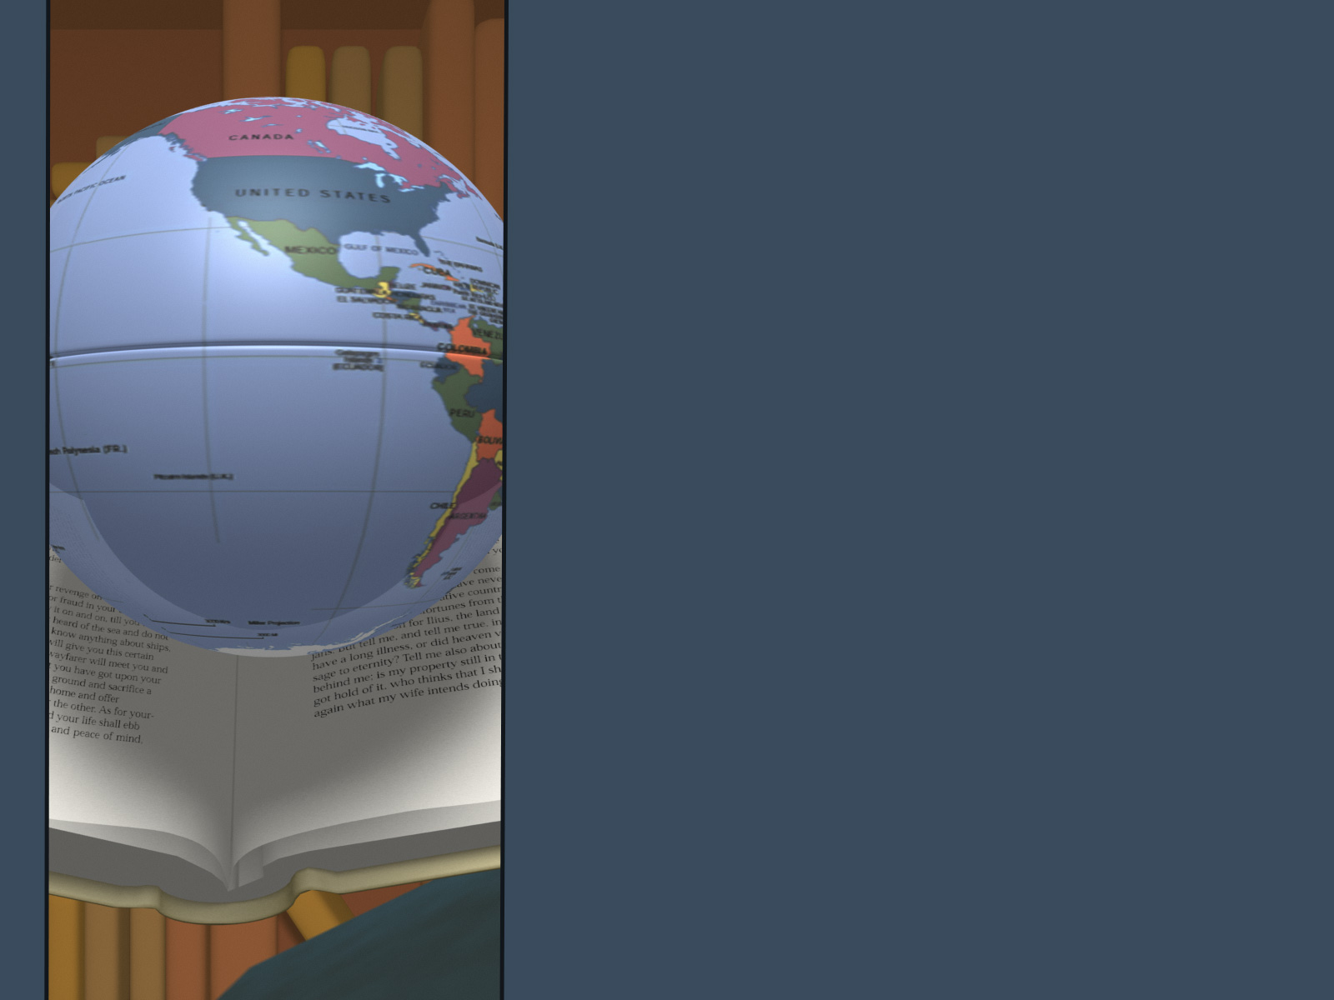
A comparison of two objects
Using the words “like” or “as”
METAPHOR
SIMILE

Slide 16
Try Again!

Slide 17
That’s Great!

Slide 18
The use of words that sound
like the sound they represent
ONOMATOPOEIA
ALLITERATION

Slide 19
Try Again!

Slide 20
That’s Great!

Slide 21
A contradictory statement
that is somehow true
ALLUSION
PARADOX

Slide 22
Try Again!

Slide 23
That’s Great!

Slide 24
A reference to a person, place,
or event that an author
expects us to recognize
FORESHADOWING
ALLUSION

Slide 25
Try Again!

Slide 26
That’s Great!

Slide 27
Giving human characteristics
to an animal, concept, or
inanimate objects
PERSONIFICATION
METAPHOR

Slide 28
Try Again!

Slide 29
That’s Great!

Slide 30
A hint or clue of
what is to come
ALLUSION
FORESHADOWING

Slide 31
Try Again!

Slide 32
That’s Great!

Slide 33
When the reader knows more
about characters/events than
those involved in the story
VERBAL IRONY
DRAMATIC IRONY

Slide 34
Try Again!

Slide 35
That’s Great!

Slide 36
When a person says one thing
and means another thing
VERBAL IRONY
DRAMATIC IRONY

Slide 37
Try Again!

Slide 38
That’s Great!

Slide 39
When actions have an effect that is
opposite from what is intended so
the outcome is unexpected
DRAMATIC IRONY
SITUATIONAL IRONY

Slide 40
Try Again!

Slide 41
That’s Great!

Slide 42
A feeling of anxiety or anticipation
that is felt by the reader while
waiting for the outcome of an event
SUSPENSE
ALLUSION

Slide 43
Try Again!

Slide 44
That’s Great!

